Slide 1
Stock Market Prediction Using LSTM with Attention and Convolutional Layers
Aashay Chaudhari, Benjamin Middleton

Slide 2
Agenda
01
02
03
04
Introduction and Background
Project Process
Results and Future Work
Relevant Research

Slide 3
01
Introduction and Background

Slide 4
Background and Problem Description
-> Market Prediction with AI -> Open problem -> Improving, but not yet professionally viable on a large scale
-> Combining recent improvements -> Machine learning techniques -> Computational power
-> Can we make a model that can predict closing stock prices of the next day?
-> Can we extend such a model to understand long-term trends?

Slide 5
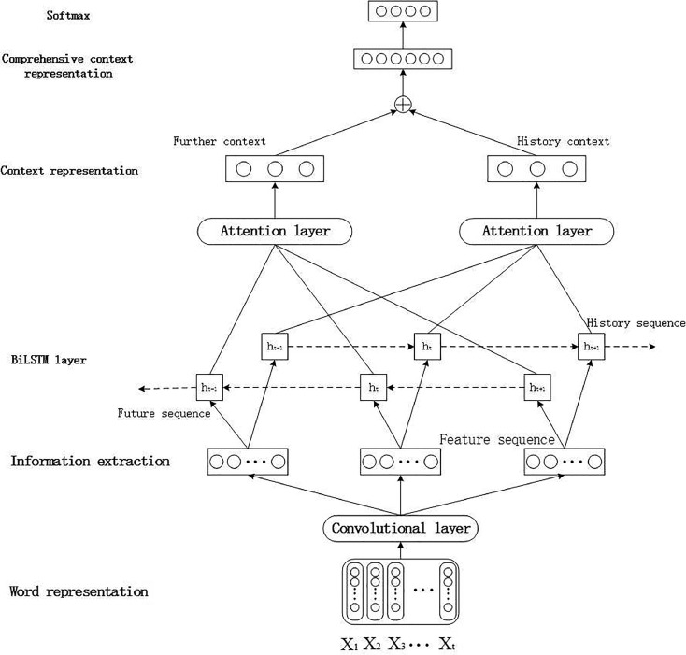
Model Components
-> Previously, we presented AC-BiLSTM
-> Which components of this model make sense for the context of market prediction?
-> LSTM recognizes time-series patterns
-> No use in Bi-LSTM
-> Convolution helps to recognize complex patterns
-> Attention helps amplify relevant patterns/data
-> AC-LSTM
AC-BiLSTM, an architecture for text classification

Slide 6
02
Project Process

Slide 7
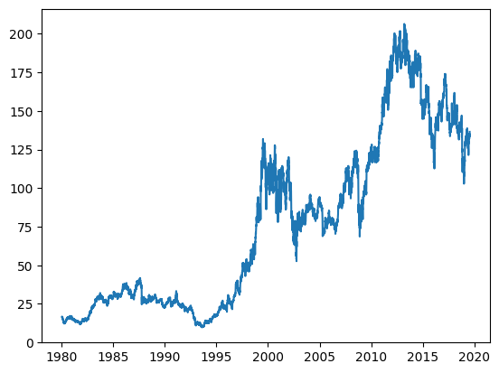
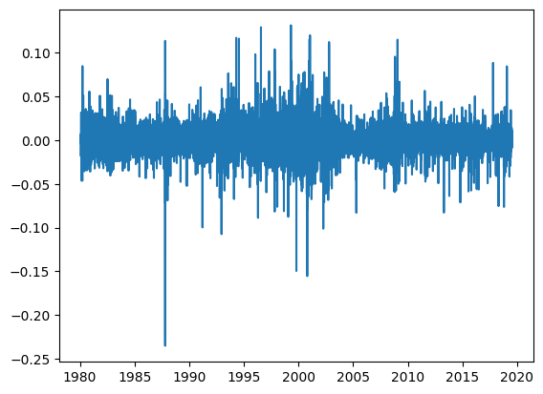
Properties of base features
The base features for the problem statement include the Open, Close, High, Low, and Volume of the stock for a particular trading session.
Inherently, this data is not stable in the sense that it can be ever increasing. For this, we convert the data in a suitable form by applying scale normalization. This transformation helps in statistical modelling as the transformed data is normally distributed.

Slide 8


Standardization/Normalization
-> Standardization: Resulting range -> 0 mean with unit variance
-> Normalization: Resulting range -> (0, 1)

Slide 9
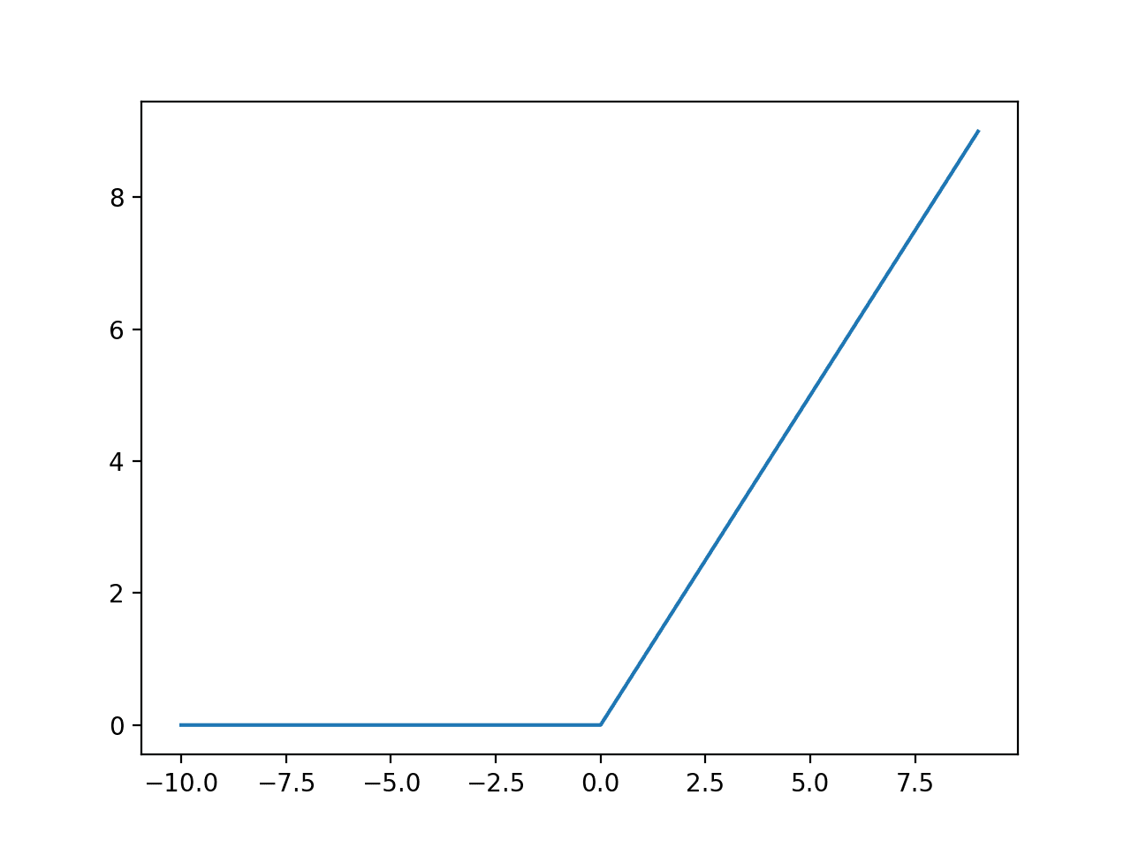
Selection of activation function
One of the things we realized is the selection of scaling function affects the selection of which activations you use. For instance, the most popular activation function Relu ignores negative values during gradient calculations.
Ideally, through gradient descent the model should learn to compensate for this by multiplying itself by -1, but we can avoid this step and use a suitable activation function like tanh for standardization or relu/sigmoid for normalization.
This would lead to more consistent results and faster convergence.

Slide 10
Where to add Attention?
Comparison of the models:
-> Convolution -> LSTMs -> Attention -> Dense
Accuracy Score: 78.5%
-> Convolution -> Attention -> LSTMs -> Dense
Accuracy Score: 80.2%

Slide 11
Regression Vs Classification?
Regression :
-> Try to predict next day opening price. If predicted price is positive, replace by BUY signal, else SELL signal
Classification:
-> Try to predict next day opening price, either BUY or SELL.
Similarity: Features, layer orientation, hyperparameters
Different: End activation (regression->tanh, classification -> sigmoid), loss functions ( regression -> mse, classification -> binary crossentropy)

Slide 12
Regression Vs Classification
Method | Accuracy Score
Regression | 81%
Classification | 60%

Slide 13
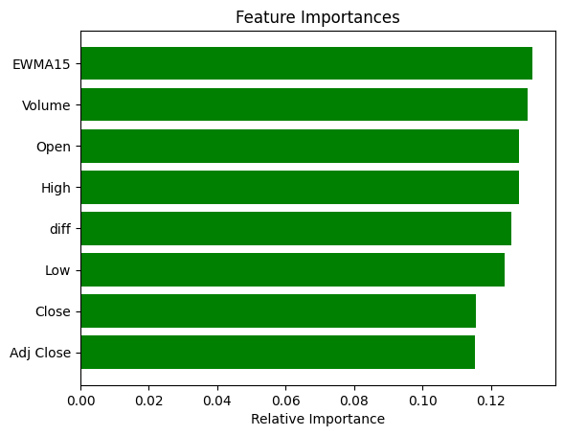
Feature importance ( Just an overview)
Just to get a overview of feature importance, we ran the data and tried to classify it using a Random Forest Classifier. It gave a 72% accuracy. The below screenshot shows the feature importance it learnt.

Slide 14
03
Results and Future Work

Slide 15

Model Comparison
-> We compared our model to common ML methods for market prediction
-> Above are four of the best and most commonly used compared to ours
-> Ours outperforms others significantly on IBM and S&P 500 data.
-> Overall a slight improvement over the other methods

Slide 16
Other Results/Observations
-> The models were trained separately on each dataset, but generalise well -> 5-10% accuracy decrease on the other dataset
-> After all the improvements to ML methods… -> Predicting single day trends with some success -> Multi-day trends are still out of reach
-> Majority of investors want more than 1-day trading

Slide 17
Future Work
-> Investigating our model on datasets that cover large loss periods
-> Long-term (multi-day) predictions are still an open problem
-> Making this kind of AI explainable is critical for investors

Slide 18
04
Relevant research

Slide 19
Sequence prediction for next 5 days
-> We further tried to use different models to predict the next 5 day closing prices using univariate features. The features we selected were the closing price and exponential closing price.
Different models we tried are:
-> Neural Networks
-> LSTMs with Attention
-> Auto Encoders
-> GANs

Slide 20
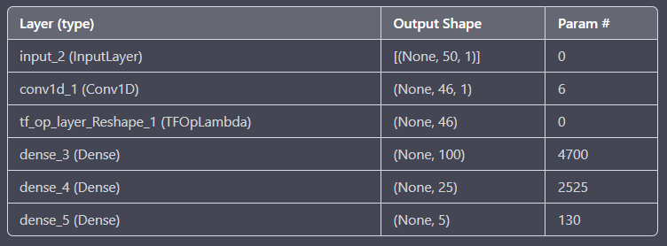
Neural Network Architecture

Slide 21
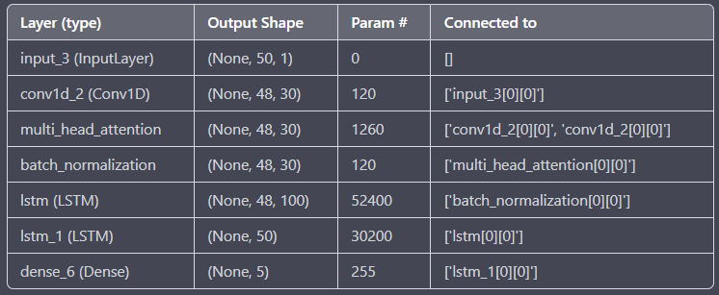
LSTM Architecture

Slide 22
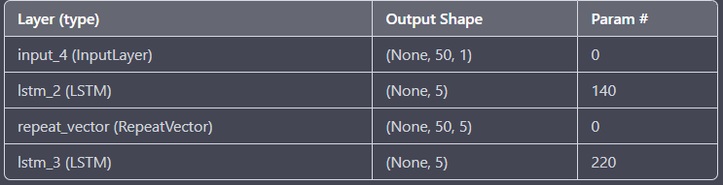
Auto Encoder Architecture

Slide 23
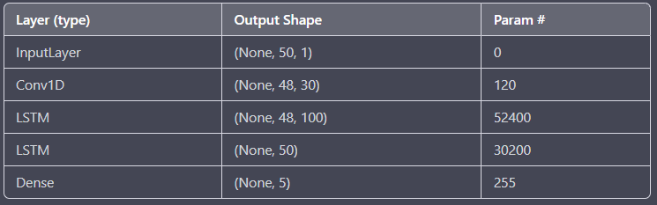
GAN (Generator Architecture)

Slide 24
Results
Model | MSE
Neural Network | 0.019656648859381676
LSTM with Attention | 0.019144956022500992
Auto Encoders | 0.01910853013396263
GANs | 0.019043496045988224

Slide 25
Thanks!

